Slide 1

Usability
Info 498B – Android
Joel Ross
Spring 2016

Slide 2
Prototype Presentations (Wednesday, in-class)
Randomly chosen "volunteer"
Will use app without any prompting/guidance
Think-aloud protocol
Whole-class feedback/discussion

Slide 3
User Interfaces

Slide 4
What makes a user interface "good" or "bad"?

Slide 5
Design Principles
Rules that describe "best practice" for (user interface) design.

Slide 6
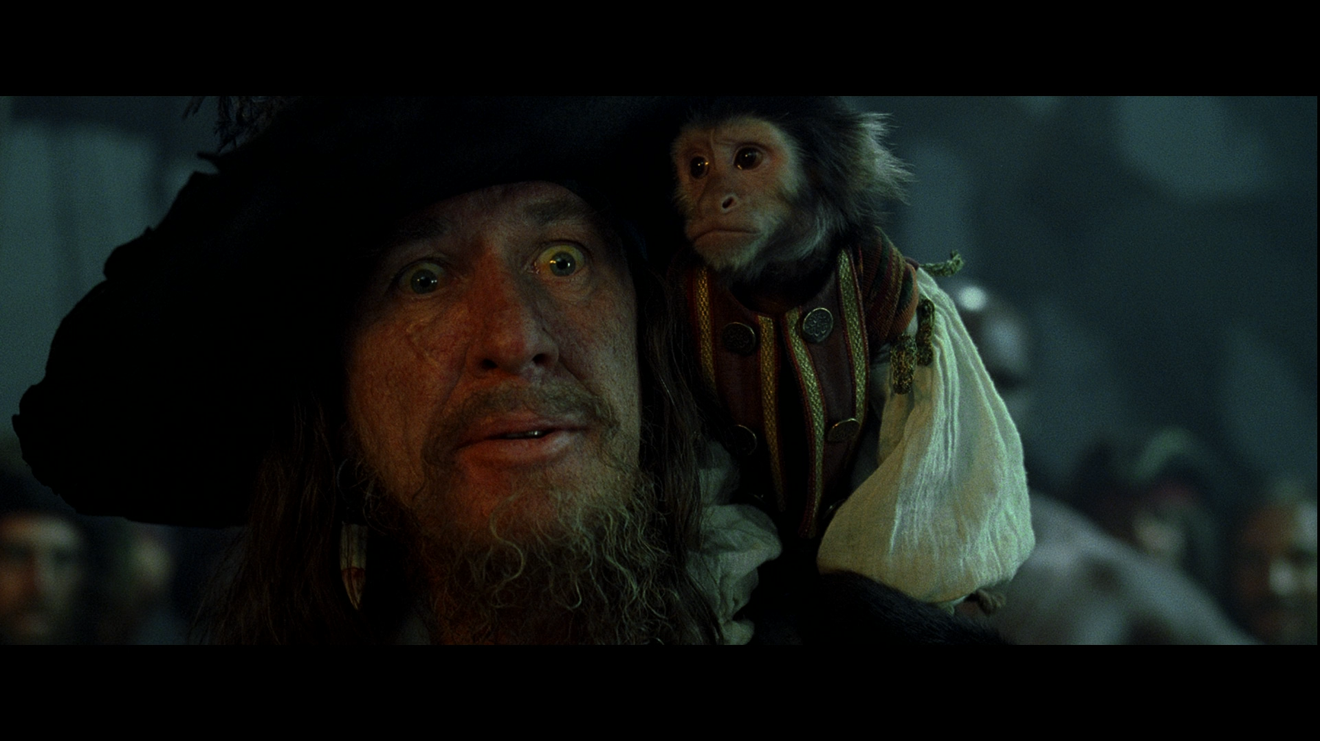
Not so much rules
as guidelines...

Slide 7
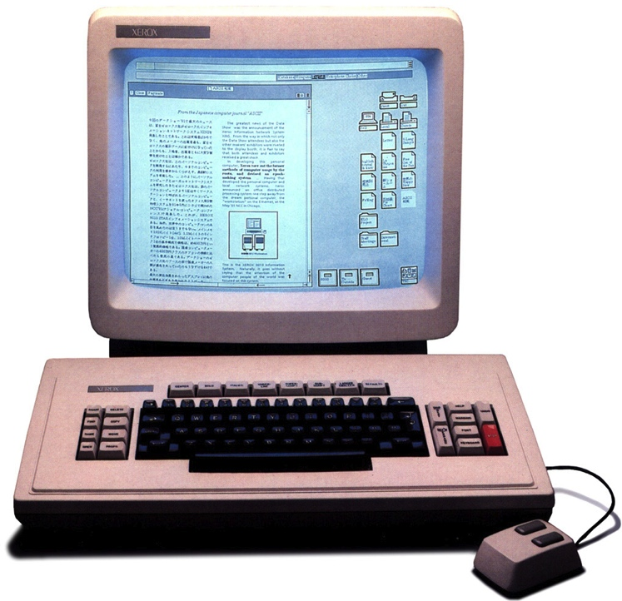
Example: Xerox STAR (1981)

Slide 8
Some STAR UI Principles
Familiar User's Conceptual Models
Universal Commands
Consistency
Simplicity
User Tailorability
Smith et al. (1982). Designing the Star User Interface. Byte (4), 242-282

Slide 9
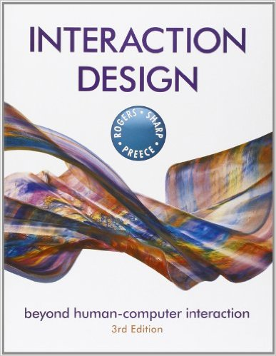
Rogers, Preece, and Sharp (2013). Interaction Design: beyond human-computer interaction, 3e. Wiley.

Slide 10
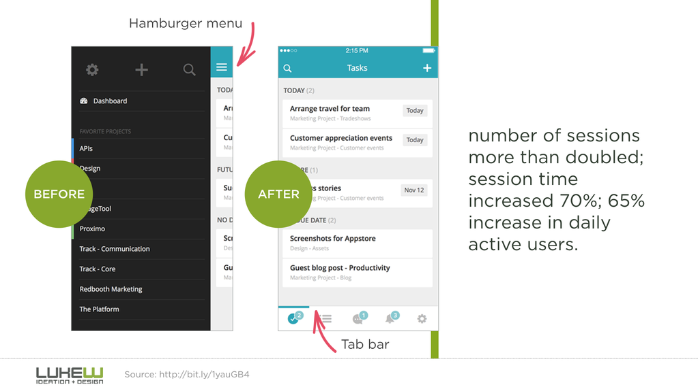
Visibility
Functions and usages should be visible to the user

Slide 11
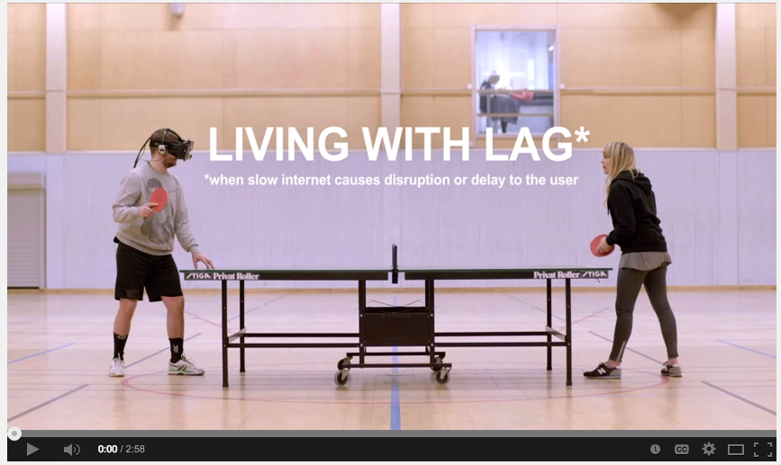
Feedback
Let the user know what is happening!
https://www.youtube.com/watch?v=_fNp37zFn9Q

Slide 12
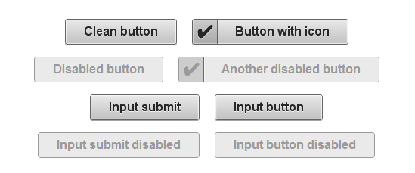
Constraints
Restrict user actions to avoid mistakes

Slide 13
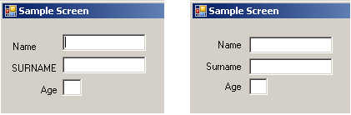
Consistency
Establish and follow expectations

Slide 14
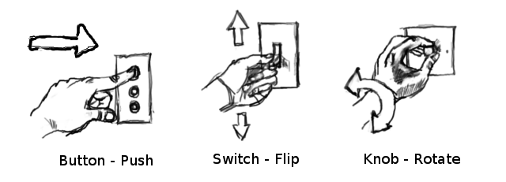
Affordance
The "actionable" properties between the world and an actor.

Slide 15

Example by Andrew Maier

Slide 16

Example by Andrew Maier

Slide 17

Example by Andrew Maier

Slide 18
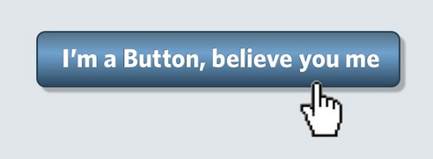
Example by Andrew Maier

Slide 19
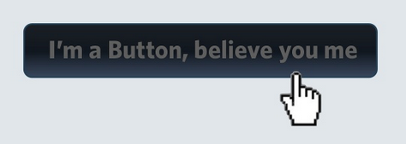
Example by Andrew Maier

Slide 20
AN INTERFACE SHOULD
Look the way it works Work the way it looks

Slide 21
Golden Rules
Strive for consistency.
Cater to universal usability.
Offer informative feedback.
Design dialogs to yield closure.
Prevent errors.
Permit easy reversal of actions.
Support internal locus of control.
Reduce short-term memory load.
Shneiderman & Plaisant

Slide 22
Golden Rules
Strive for consistency.
Cater to universal usability.
Offer informative feedback.
Design dialogs to yield closure.
Prevent errors.
Permit easy reversal of actions.
Support internal locus of control.
Reduce short-term memory load.
Shneiderman & Plaisant

Slide 23
Golden Rules
Strive for consistency.
Cater to universal usability.
Offer informative feedback.
Design dialogs to yield closure.
Prevent errors.
Permit easy reversal of actions.
Support internal locus of control.
Reduce short-term memory load.
Shneiderman & Plaisant

Slide 24
Golden Rules
Strive for consistency.
Cater to universal usability.
Offer informative feedback.
Design dialogs to yield closure.
Prevent errors.
Permit easy reversal of actions.
Support internal locus of control.
Reduce short-term memory load.
Shneiderman & Plaisant

Slide 25
Universal Usability
Systems should be able to address the needs of ALL users

Slide 26
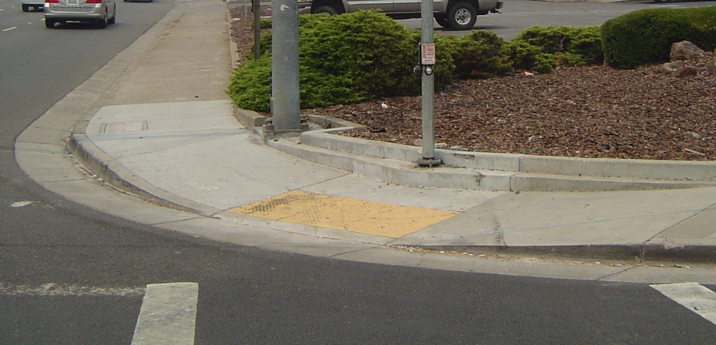
Classic Example: Curb Cuts

Slide 27
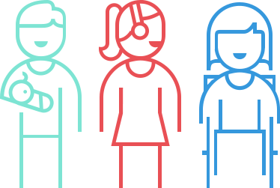
Supports Temporary Disabilities

Slide 28
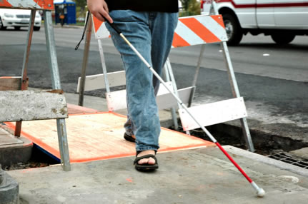
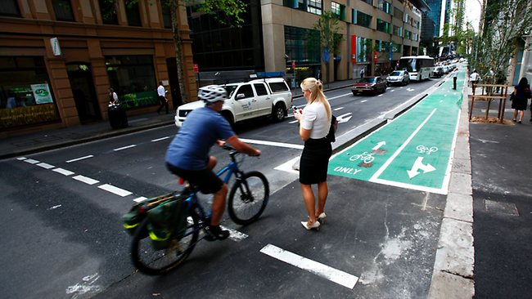
Mobile Universal Design

Slide 29
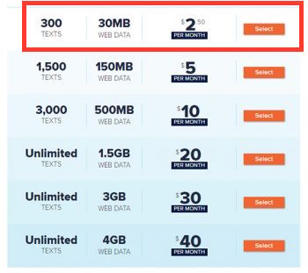

Mobile Universal Design

Slide 30
Android Universal Design
Can support different users (and User Tailorability) by using dynamically-loaded resources (XML)

Slide 31
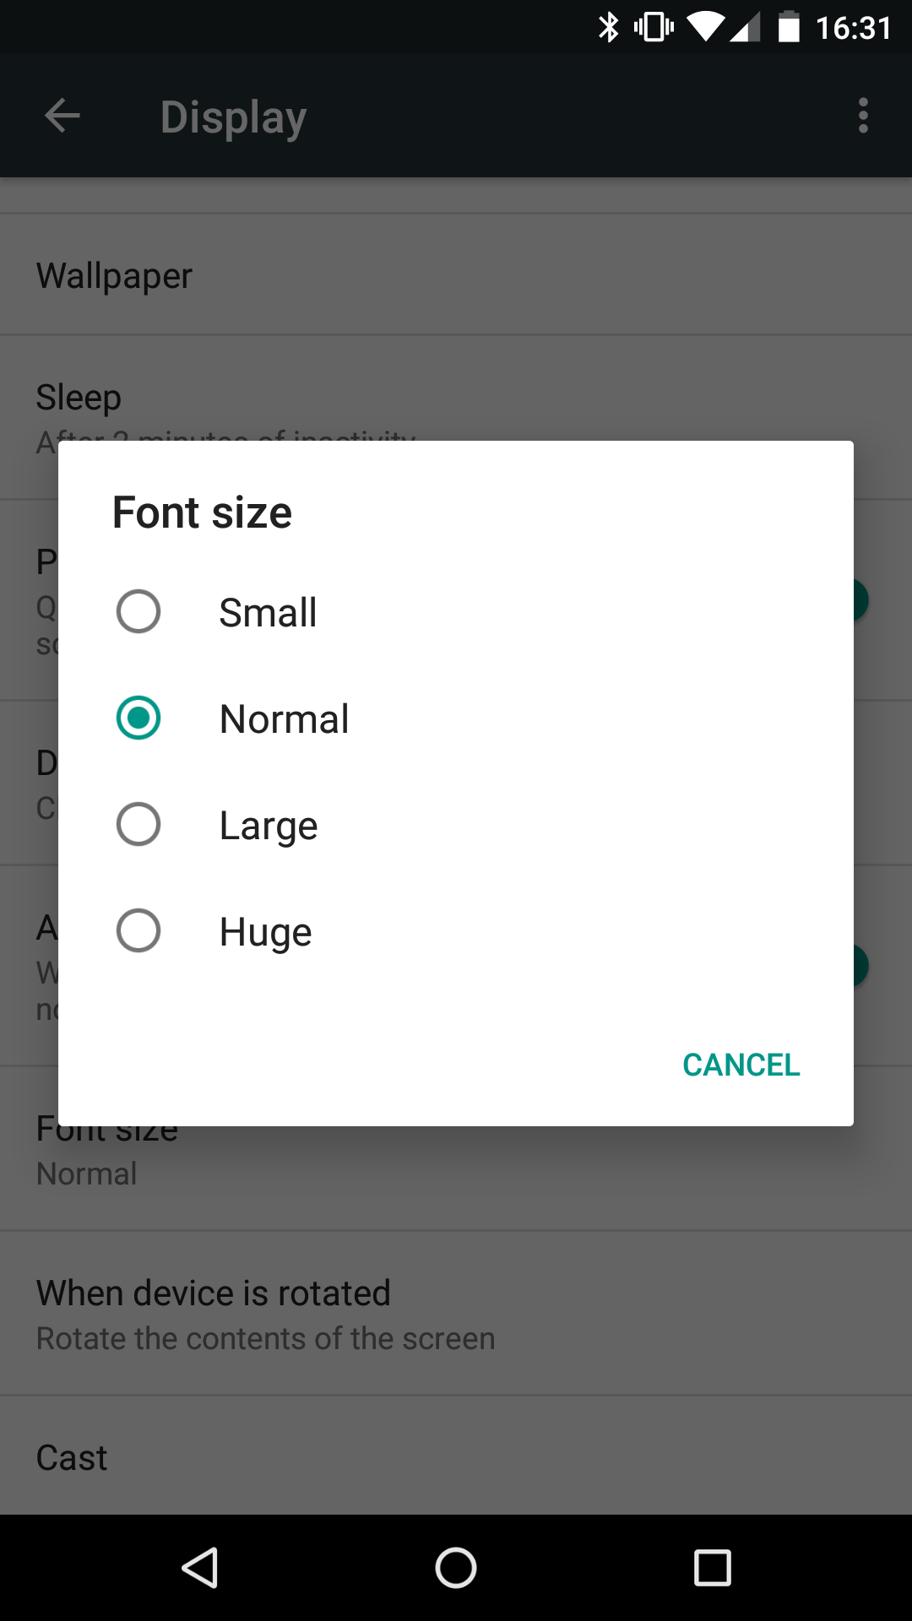
Specifying Font Size
Settings -> Display -> Font Size

Slide 32
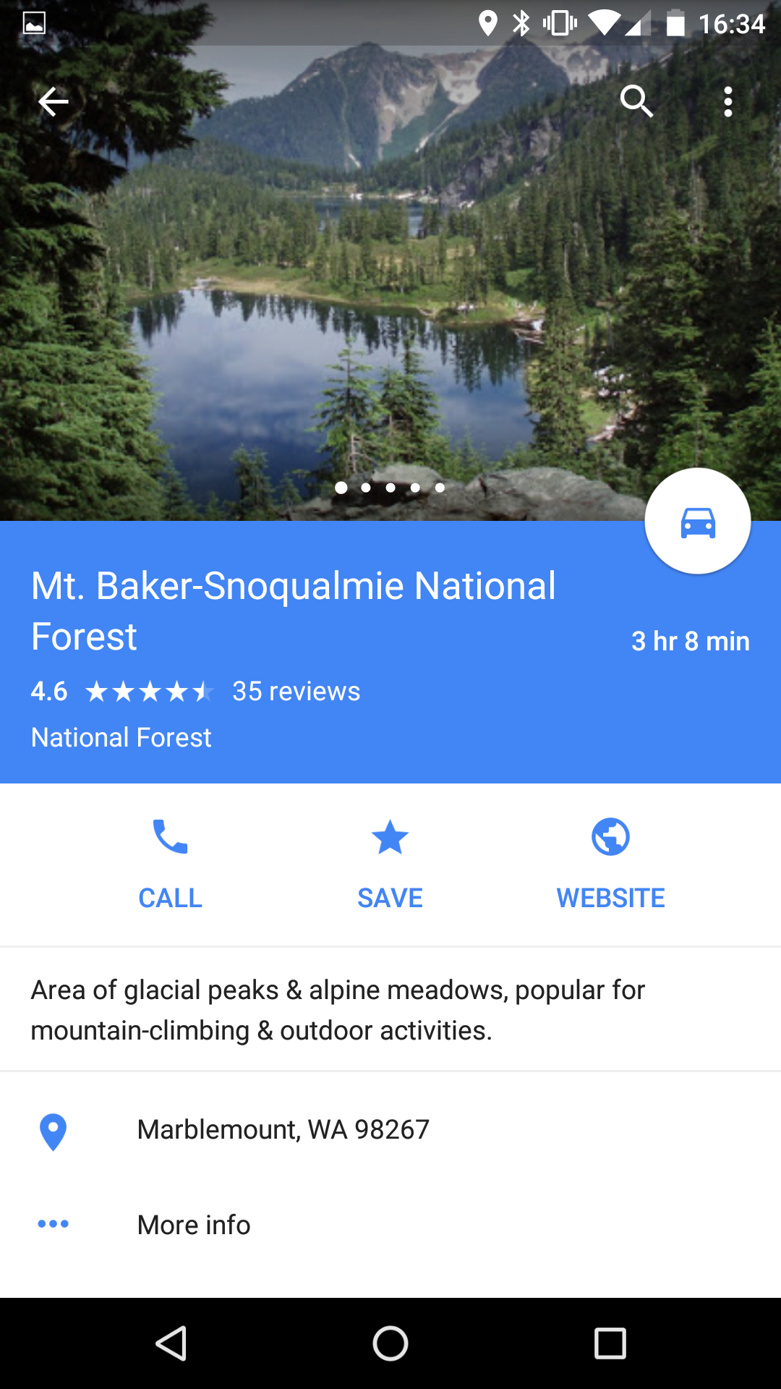
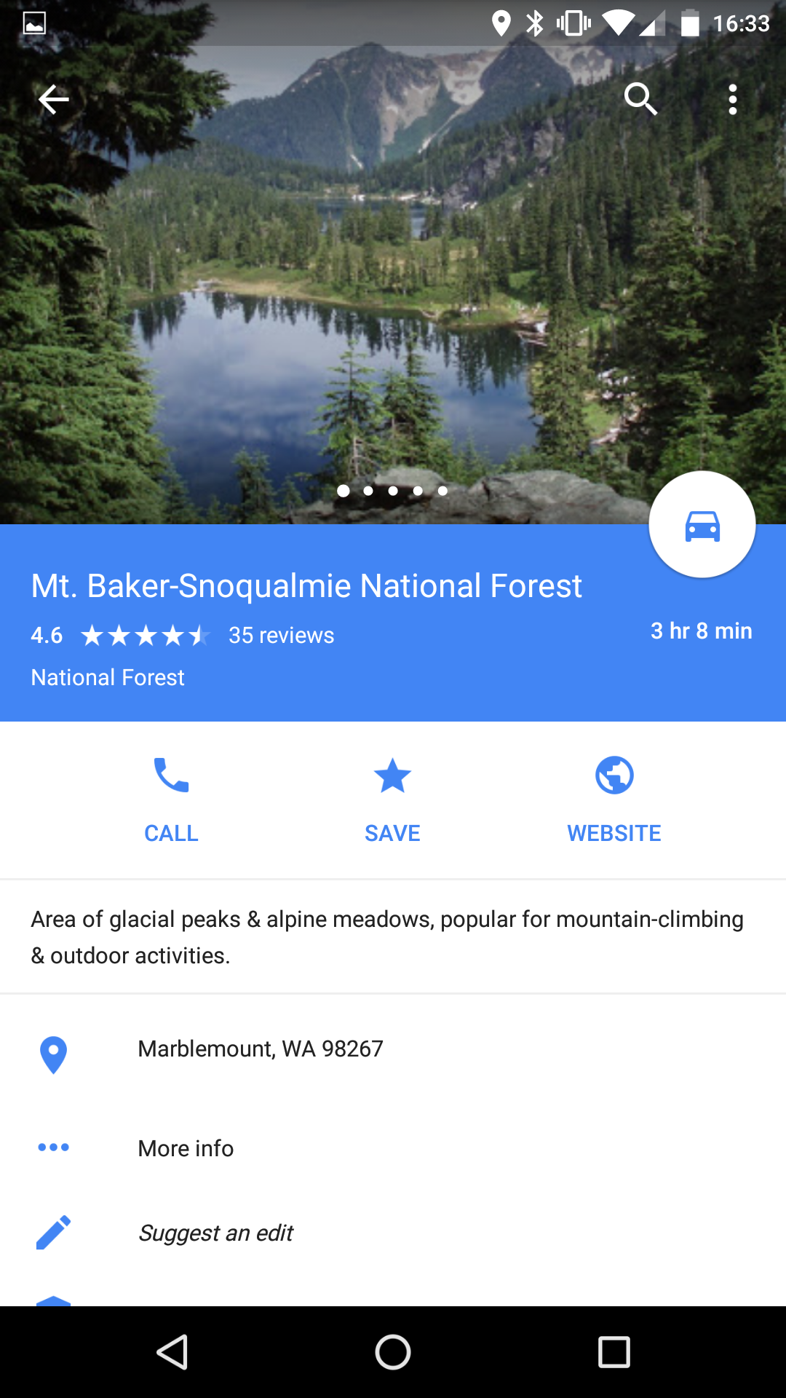
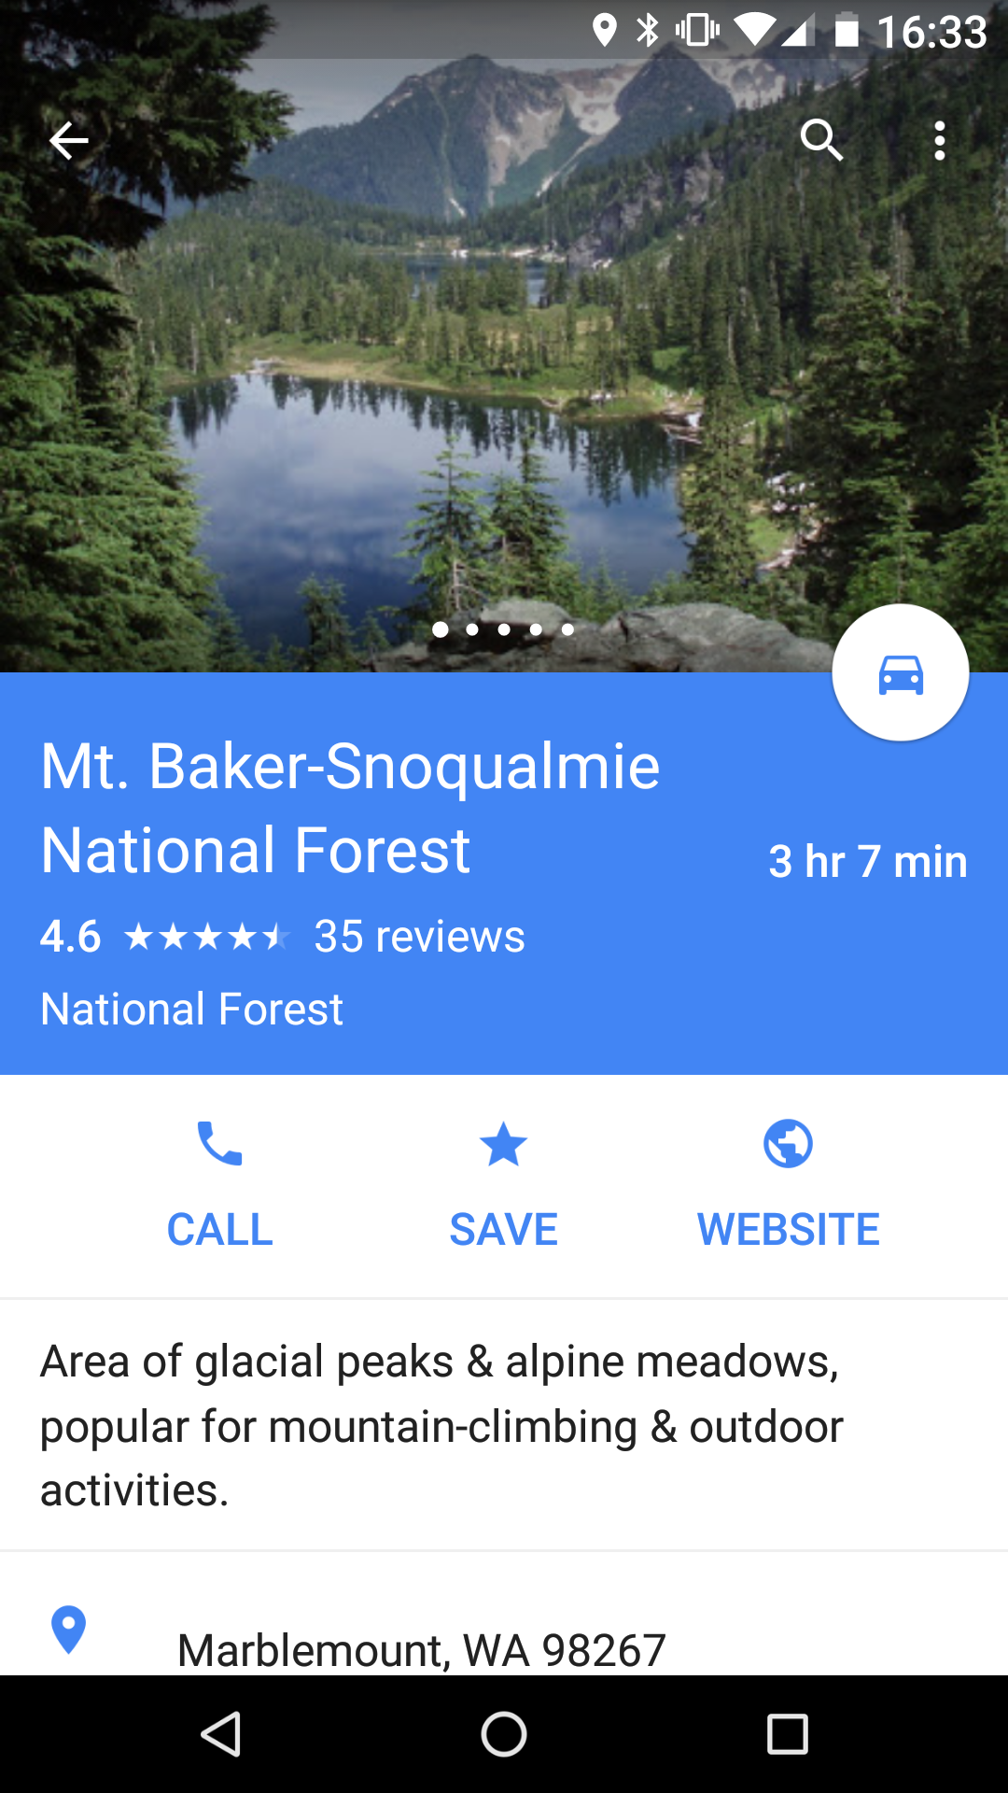
Huge
Normal
Small
Huge

Slide 33
Supporting Font Sizes
px dp
sp
raw screen pixel density-independent pixel scale-independent pixel
20 pixels 10 dp @xhdpi (2x) px = dp * density 5 sp @huge @xhdpi px = sp * density * scale
(almost) never use use most places! use for ALL fonts & things that track text

Slide 34
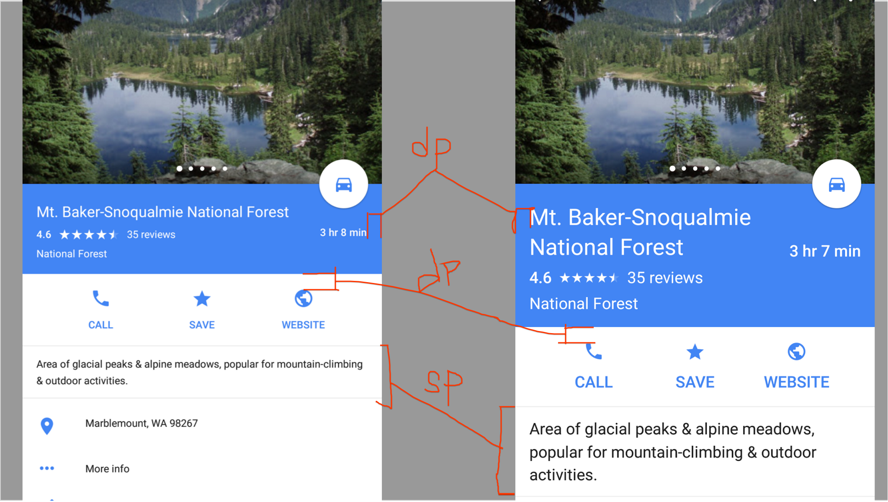

Slide 35
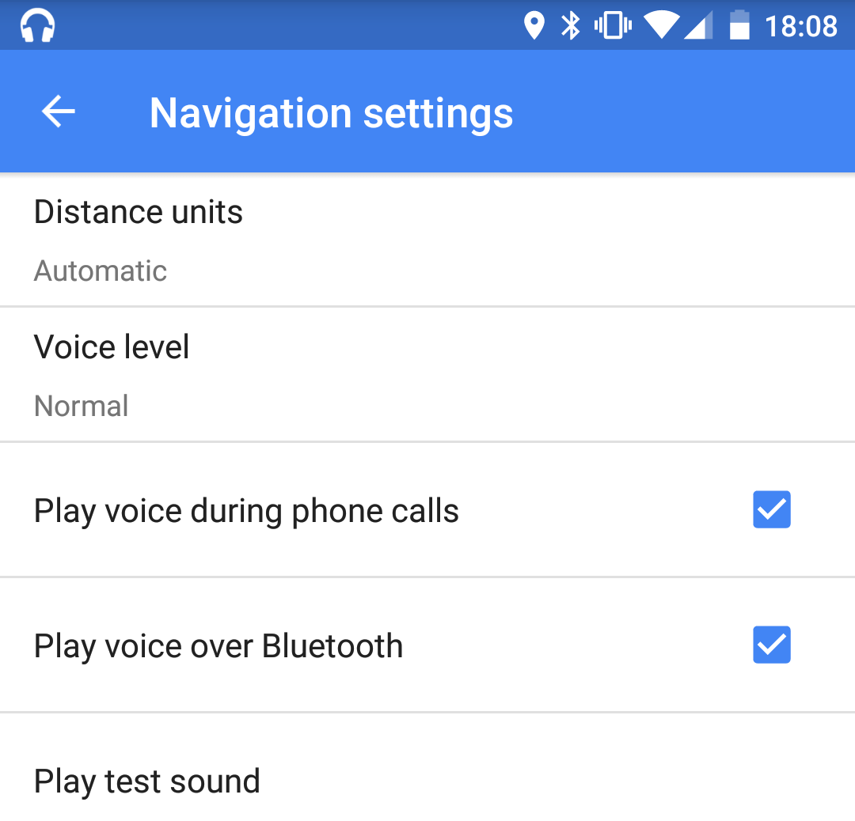
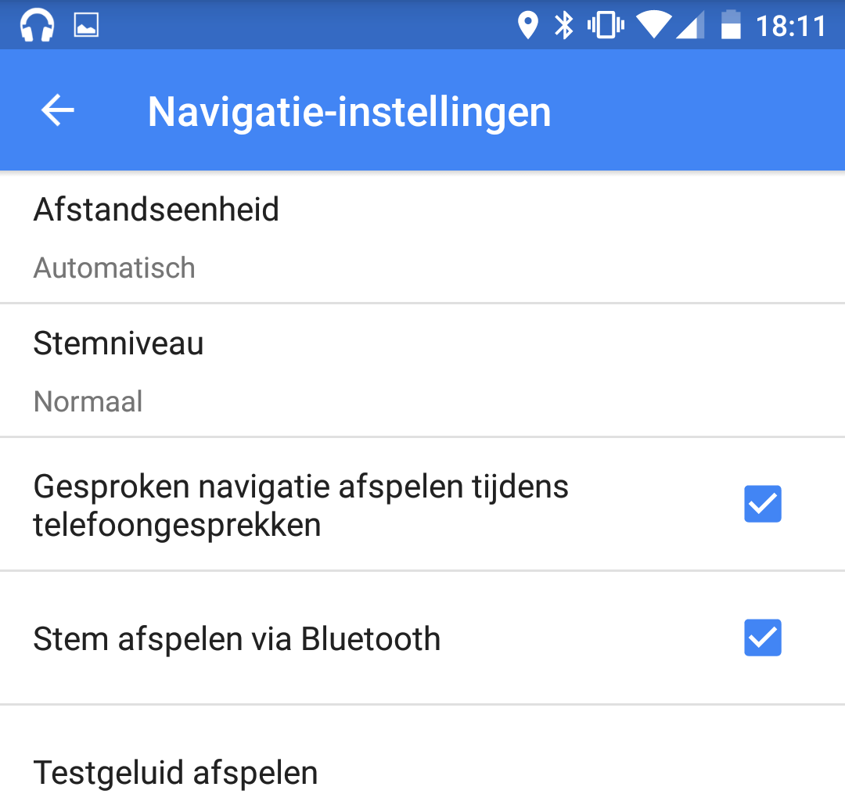
Internationalization (language)
can change sizing as well

Slide 36
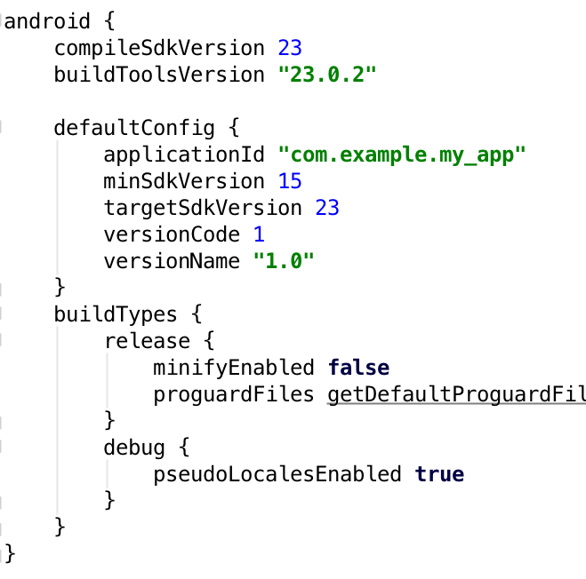
Pseudo-localization
Enable in build.gradle

Slide 37
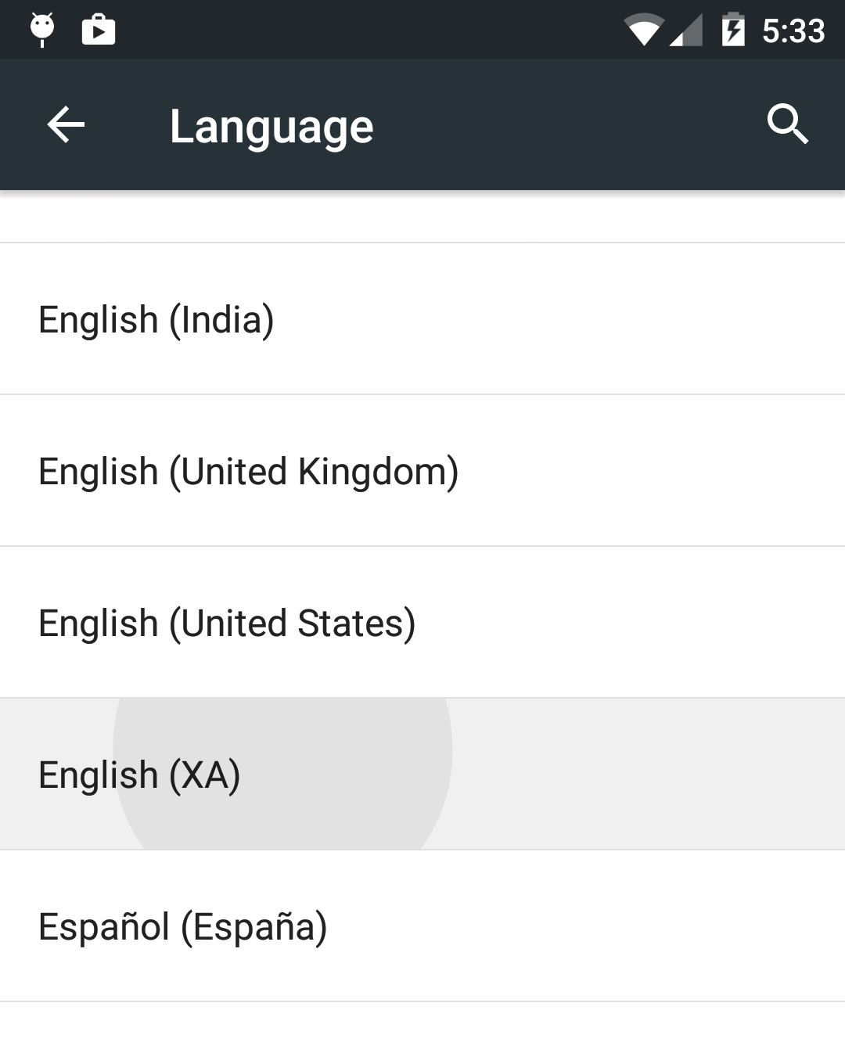
Pseudo-localization
Enable in build.gradle
Change local to English (XA)

Slide 38
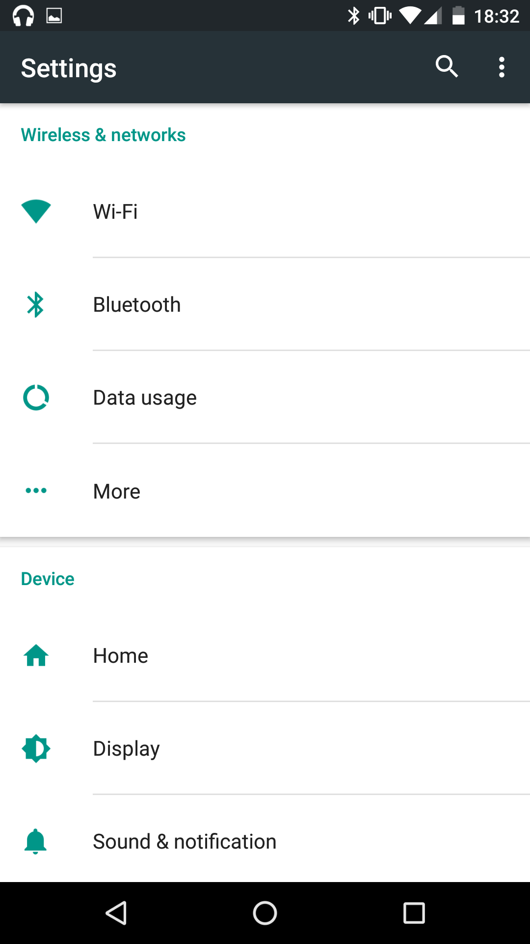
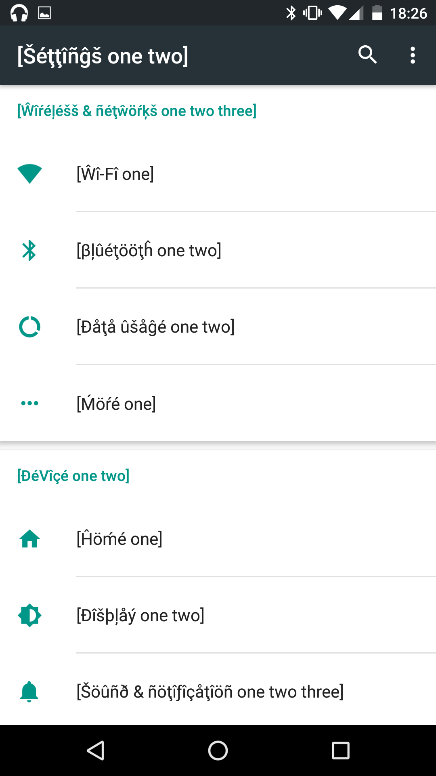

Slide 39
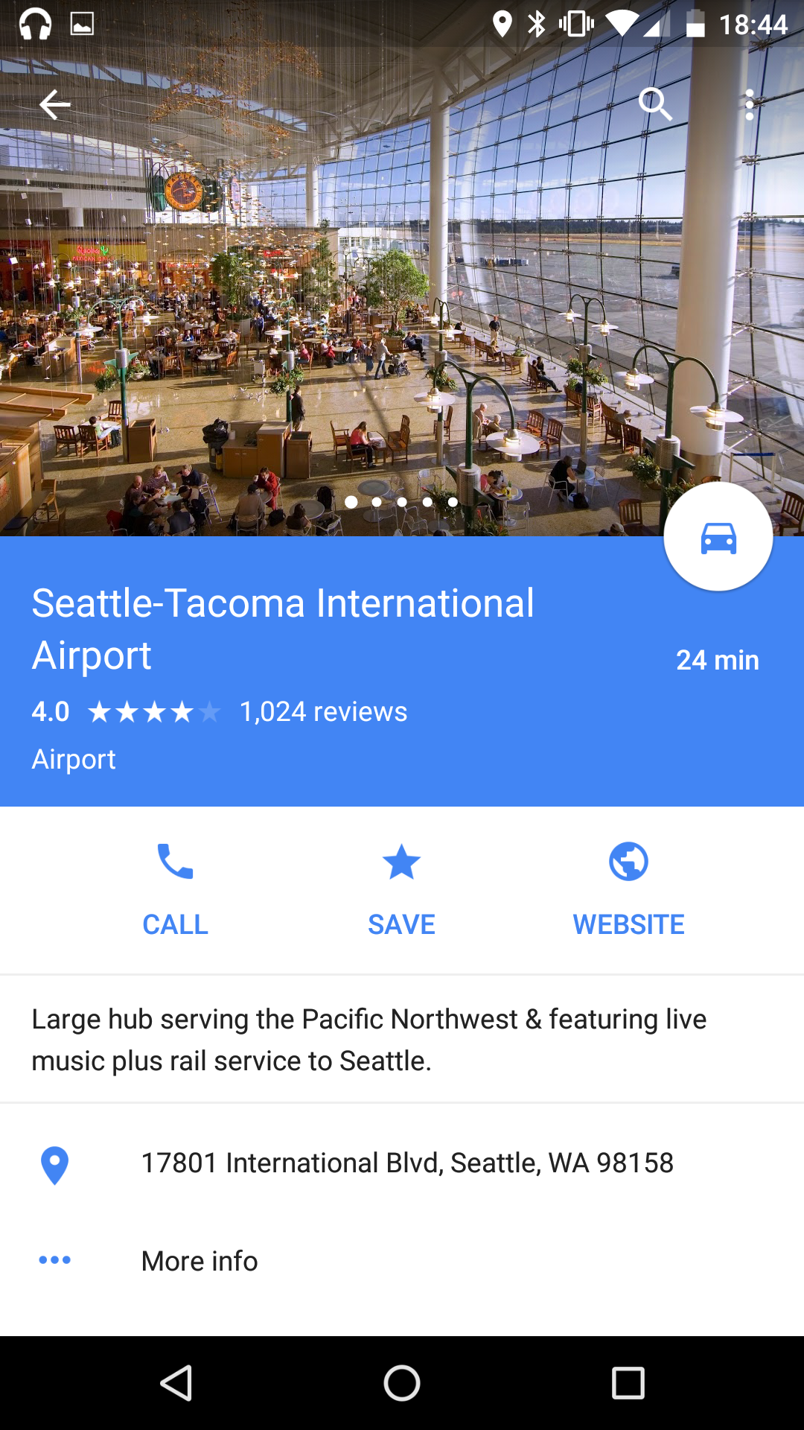
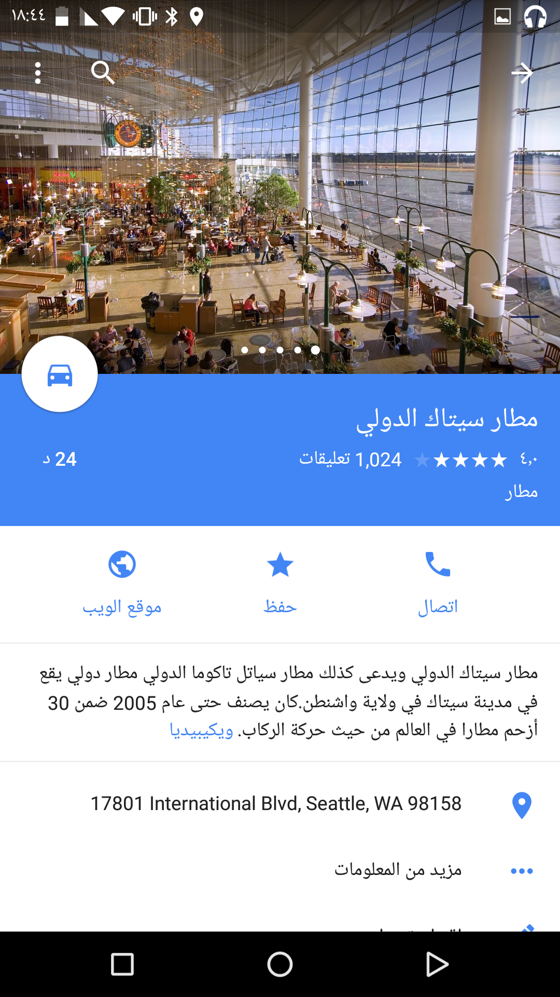
Right-to-left (RTL) Languages

Slide 40
Supporting RTL
Declare in Manifest
<application
android:icon="@mipmap/ic_launcher"
android:label="@string/app_name"
android:supportsRtl="true"
android:theme="@style/AppTheme">
...
</application>
Use start and end, not left and right
layout_marginLeft=”5dp”
layout_marginRight=”5dp”
android:layout_gravity=”left”
android:layout_gravity=”right”
paddingLeft=”5dp”
paddingRight=”5dp”
android:gravity=”left”
android:gravity=”right”
layout_marginStart=”5dp”
layout_marginEnd=”5dp”
android:layout_gravity=”start”
android:layout_gravity=”end”
paddingStart=”5dp”
paddingEnd=”5dp”
android:gravity=”start”
android:gravity=”end”

Slide 41
RTL: RelativeLayout
android:layout_alignParentStart=true
android:layout_toEndOf=id/box1
android:layout_alignParentEnd=true

Slide 42
RTL: LinearLayout
Flipped automatically!

Slide 43
RTL: Drawables

Slide 44

RTL: Drawables
res/drawable-xhdpi/back_button.png:
res/drawable-ldrtl-xhdpi/back_button.png:

Slide 45
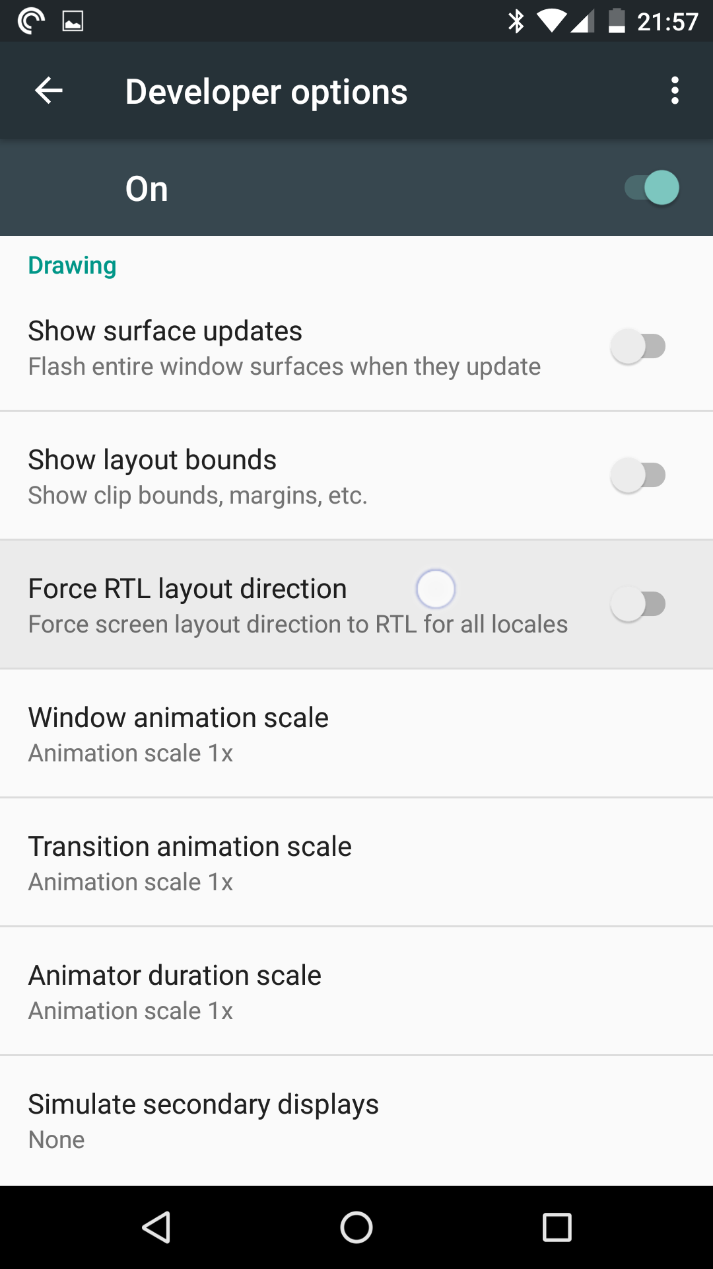
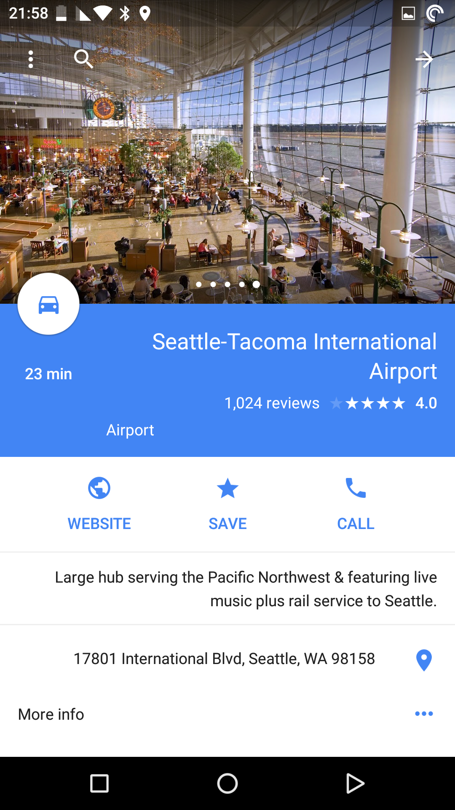
RTL: Developer Mode

